Slide 1
Balancing
Lecture sponsored by personal trust

Slide 2
Terminology
Opener- person who opens the bidding
Responder – partner of the opener
Overcaller – player who enters the bidding after the other side has opened
Advancer – partner of the overcaller
Direct seat – next player to bid after the opener
Pass out seat – player whose turn it is to bid after 2 passes
Fit – minimum of 8 cards in a suit held by the partnership

Slide 3
Balancing seat
When a pass by you will end the auction – you are in the balancing seat
Avoid leaving opponents in a contract that they are comfortable with - don’t sell out cheaply

Slide 4
Two auctions will be discussed
Auction 1
North east south west
1x p p ?
Auction 2 North East South West 1♥ P 2♥ P P ??

Slide 5
Auction 1 North east south west 1x p p ?
often correct to bid but
Have opponents landed in the wrong partscore ? – be careful if you have shortage in an unbid major
If you have length in X this makes it less likely that partner has values to bid and the chance of you finding a fit is decreased
Shortage in X makes it attractive to bid
The longer you are in X and the shorter in unbid majors, the more you need in high cards to balance
The shorter you are in x and the longer in unbid majors, the more you should strain to balance
Our side will have on average 20-22 hcp and theirs will have 18-20 hcp
When in doubt, bid rather than pass

Slide 6
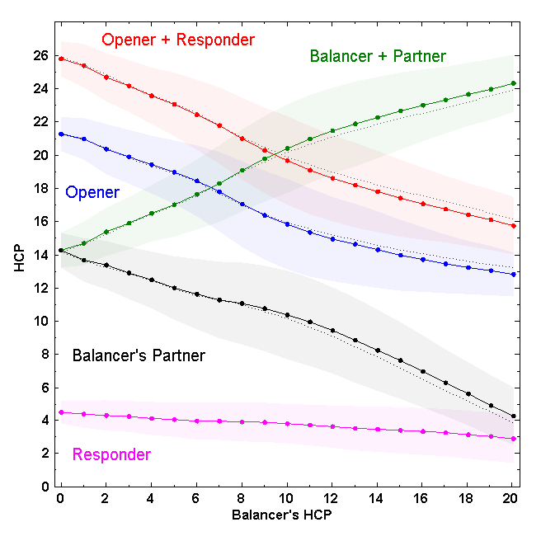

Slide 7
options
Takeout double
1NT
Overcall in a 5+ card suit
pass

Slide 8
1X – p – p - ? Double
Because you know partner has some points, a takeout double can be made with as few as 8 high card points (HcP) with the correct shape
For example 1♥– P – P ?
♠ a872 ♥4 ♦KJ83 ♣10943
Advancer needs to take this into account when responding to the double
General rule – balancer mentally adds 1 king to his hand and advancer subtracts 1 king - therefore
cheapest bid by advancer can have as many as 10-11 HCP
Jump bid shows 12-13 HCP
Cue bid shows 14-15 hcp
1Nt show 8-12 Hcp, 2NT shows 13-14 HCP, 3NT shows 15 HCP

Slide 9
Auction 1 No-trump structure in the pass out seat
There are 3 options
1NT shows 15-17
Advantage – simple, easy to remember, continuations are all familiar
Disadvantage – often do not have a bid when in the range of 11-14 EG ♠k87 ♥q102 ♦a872 ♣a82
1NT shows 11—14
ADVANTAGE – POPULAR METHOD AND COVERS A LOT OF HANDS
DISADVANTAGE – MAKES THE RANGE OF 15-17 and 21+ HCP DIFFICULT TO BID when advancer bids at the 2 level after a takeout double. for example :
(1♠) – p – (p) - d
(p) – 2♣ - (p) - 2nt SHOWS 15-17 and 3NT shows 21+ AND YOU MAY BE OVERBOARD
1nt SHOWS (11)12-16 RECOMMENDED METHOD ESPECIALLY AFTER OPENER HAS BID 1♥ OR 1♠
ADVANTAGE – OVERCOMES PROBLEMs MENTIONED IN b ABOVE and is safer as opener may have a penalty double
DISADVANTAGE – MORE COMPLICATED AND REQUIRES SPECIAL METHODS TO DEAL WITH THE WIDE RANGE
Does bidding 1NT in the passout seat promise a stopper –no

Slide 10
No-trump structure in pass out seat
1. 1NT shows 11-14 HCP
♠ AJ ♥KJ32 ♦K102 ♣10984
1♥ – P – P – 1NT
Double followed by cheapest NT bid shows 15-17
♠ AQ2 ♥ KJ2 ♦ K102 ♣K984
1♥ – P – P – D
P – 1♠ – P – 1NT
3. Direct 2NT jump shows 18-20 – give up showing both minors
♠ AKQ ♥ KJ2 ♦ K102 ♣ K984
1♥ – P – P – 2NT
4. With 21-23 hcp double and jump in NT
if advancer bids at the 2 level you may have to guess to bid game

Slide 11
Developing the auction after a balancing1NT or 2NT
Play exactly the same methods you use as after a 1NT opening or direct seat overcall
Remember you can afford to be a little more aggressive as the hand will be easier to play and opponents will often be endplayed or squeezed. High cards are most effective when split between the 2 hands

Slide 12
1nt IN PASSOUT SEAT SHOWS (11)12-16
2♣ IS a range enquiring STAYMAN
2♦ 2♥ AND 2♠ RESPONSE ARE NORMAL STAYMAN RESPONSES SHOWING 11-14 HCP
ADVANCER’S further BIDS AT THE 2 LEVEL ARE NOT FORCING
2nT BY OVERCALLER SHOWS 15-16 HCP
now 3♣ REINSTATES STAYMAN
3♦ 3♥ ARE TRANSFERS SHOWING 5 CARD SUIT GAME FORCING ONCE PARTNER HAS 15-16
DIRECT 2nT BY ADVANCER IS INVITATIONAL OPPOSITE (11)12-14 HCP
MAY CONTAIN A 4 CARD MAJOR AND OVERCALLER MAY ENQUIRE WITH 3♣ IF ACCEPTING
AFTER 3♣ BID THE SUIT BELOW (IE 3♦ WITH HEARTS AND 3♥ WITH SPADES) IN ORDER TO PUT THE OPENING BIDDER ON LEAD
2♠ can be used to sign off in either minor – 6 card suit
Double followed by nt shows 17-19 and direct 2nt shows 20-22. Jumps in NT following new suit by responder show 23-25

Slide 13
1X p p ? Overcalls
In direct seat overcalls show 8-17 HCP
Advancer strains to make another bid with 8+ HCP
In pass out seat this can be lowered to 7-15 HCP
Advancer strains to make another bid with 10+ HCP
Double followed by a new suit shows 16-19 HCP

Slide 14
1X p p ? Jumps in pass out seat
No value in pre-empting – just pass the hand out
Jump shows an opening hand 12-15 hCP and a good 6 card suit
1♥ – P – P - ?
♠ AQj432 ♥ 43 ♦ AQ8 ♣ 108
Bid 2♠

Slide 15
When shouldn’t you balance?
Do not balance with fewer than 8 hcp
With a Shortage in opener’s suit you need a minimum of 8 HCP
With a Balanced hand you need a minimum of 11 HCP
Beware if you have a shortage in an unbid major
e.g. ♠1043 ♥9 ♦ kq872 ♣ a1043 after 1♠ p p ?
pass may be best
Consider passing if you have length in their suit as opponents may have a better spot

Slide 16
After an opening pre-empt
Be careful about lowering standards for actions – responder may be lurking with significant values
Eg if your partner opens 3♥ and you have ♠AJ43 ♥ 2 ♦ KQ43 ♣ AJ87
Pass and you will be happy to double any intervention
Takeout double can be lowered to 10 with singleton or void in their suit and support for all the remaining suits
Overcall of a suit should be a minimum of an opening hand or better
Onus on bidding lies with the hand with shortage in opponents suit.
If you have length in their suit – ask why did partner not bid?

Slide 17
Auction 1
Questions ?

Slide 18
Auction 1 examples
North east south west
1♠ p p ?
A B C D
9
14
14
19

Slide 19
Auction 1 examples
North east south west
1D p p ?
A B C D
11
17
10
13

Slide 20
Auction 1 examples
North east south west
1C p p ?
A B C D
14
18
15
14

Slide 21
North east south west 1♠ p p D p ?
A B C D
11
13
10
6

Slide 22
North east south west
1♥ p p d
2♥ ?
What does double mean
What does 2NT mean

Slide 23
North east south west 2♥ p p ?
A B C D
10
15
16
12

Slide 24
North east south west 3♥ p p ?
A B C D
10
16
12
13

Slide 25
Examples from play

Slide 26
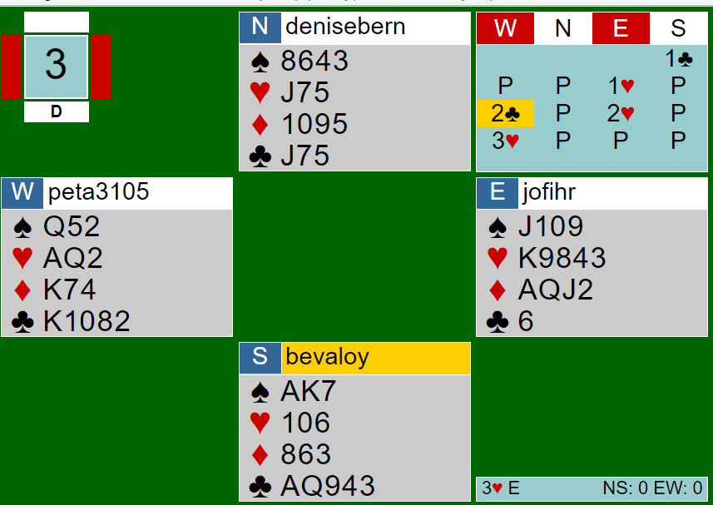

Slide 27
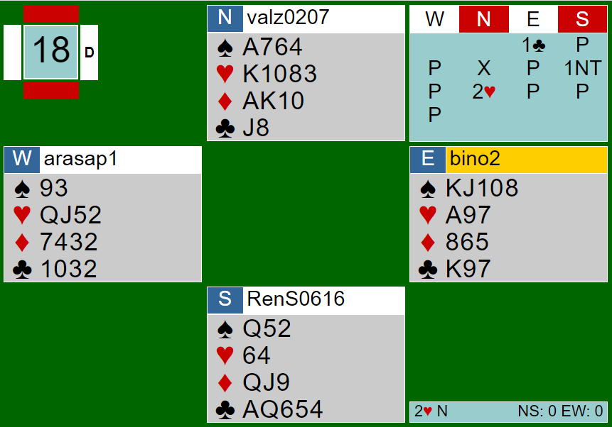

Slide 28
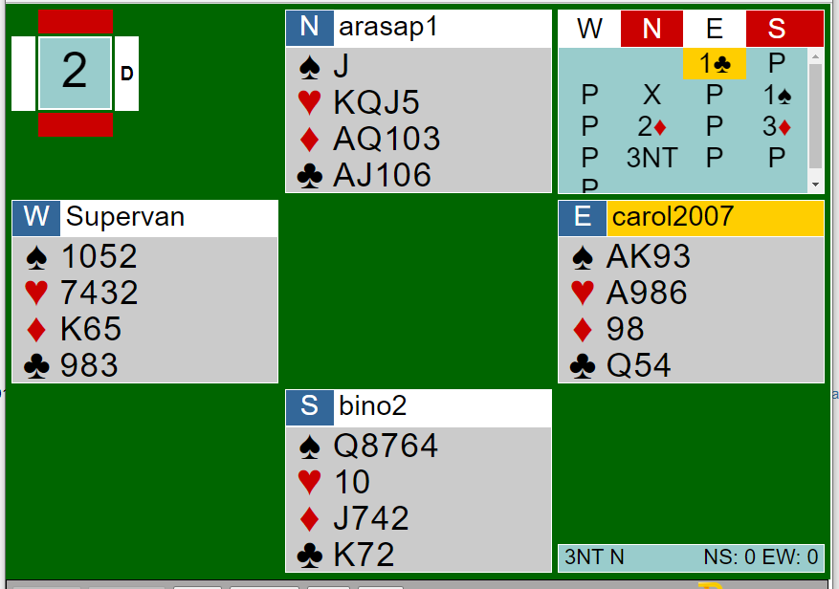

Slide 29
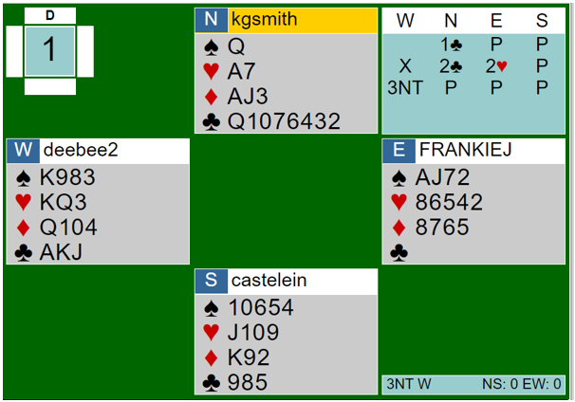

Slide 30
Auction 2 North East South West 1♥ P 2♥ P P ??
Don’t think that because partner has passed and I have passed that we are out of the auction
Don’t worry about how many points you have as partner’s points will complement yours
Don’t worry about pushing opponents to game – if they have not made a try it is very unlikely that they will be able to bid and make a game

Slide 31
Auction 2 North East South West 1♥ P 2♥ P P ??
When opponents have a fit we also have a fit
It is therefore safer to compete WHEN they have a fit
They will be reluctant to double you when they have a fit as their defensive values may not be working well
If they don’t have a fit, neither do we
Dangerous to compete
Opponents know their defensive values are working

Slide 32
Do they have a fit ?
1♥ – 2♥ ? 7. 2♥ - p - ?
1♥ – 1NT 8. 1♣ - 1♦
2♦ - 2♥ ? 2♣ - p - ?
1♣ – 1NT 9. 1Nt – 2♦
2♣ - P ? 2♥ - p ?
1♥ – 2♦ 10 1♠ – 1nt
2♥ - P ? 2♣ – p ?
1♦ – 1NT 11 1♦ – 1♥
2♦ - p ? 1♠ – p
1♥ – 1NT
P - p ?

Slide 33
What can we do in the balancing seat
Double is the most common action and shows support for the remaining suits
2NT can be used to show 2 suits - does not make sense to bid a natural 2NT
North East South West
1♥ P 2♥ P
P ?
♠ 32 ♥104 ♦A873 ♣K8432 - bid 2NT= minors
North East South West
1♠ P 2♠ P
P ?
♠ 832 ♥A872 ♦2 ♣AJ873 - bid 2NT to show 2 places to play
Overcall in a suit – this is dangerous – opponents know that you don’t have a good suit or good values and will be quick to pounce

Slide 34
PARTNER HAS MADE A BALANCING DOUBLE
Prefer to Bid at the 2 level if possible
Improve your methods to find a fit after a balancing double
2nt is rarely the correct place to play when the points are evenly divided – neither side can make 2nt
2nt should indicate that you have 2 places to play
It is highly unlikely that you can make game
do not jump the bidding even if you have assets that you were unable to show
Partner is bidding on the basis that he knows you have points
The more points you have the fewer partner will have

Slide 35
When should you Not balance
They have no fit
You have soft values in their suit – this means that your share of the values may not be working well for offense
Be wary of forcing the partnership to the 3 level especially when vulnerable playing pairs
Don’t think that a delayed entry into the auction just shows a hand or suit that was not good enough to come in the first time – opponents are also listening. It is much easier to double a late entry for penalties

Slide 36
Pairs versus teams
pairs
teams
-50 or -100 is much better than -110
An overtrick on another hand can compensate for a disaster
Opponents will be quick on the trigger particularly when you are vulnerable
You just have do the right thing more than half the time to register a gain
No difference
Difficult to make up a loss of 10 or 13 imps when things go wrong
Opponents are reluctant to double which risks scores like -670
You have to do the right thing most of the time

Slide 37
Opponents take the push and bid one more
Do not bid again !!
unless
You have a big fit
You have extra shape
Hcp do not matter

Slide 38
Auction 2
Questions?

Slide 39
Auction 2 examples
North east south west
1♥ p 2♥ p
p ?
A B C D
9
10
13
11

Slide 40
North east south west 1♥ p 2♥ p p ?
A B C D
10
7
6
16

Slide 41
North east south west 1♠ p 2♠ p P ?
10
11
12
7

Slide 42
North east south west 1♠ p 2♠ p P ?
A B C D
12
10
9
9

Slide 43
North east south west 1♠ p 1nt p 2 ♣ p 2♠ p p ?
A B C D

Slide 44
North east south west 1♠ p 1nt p 2 ♣ p 2♠ p p ?
A B C D

Slide 45
North east south west 1♣ p 1NT p p ?
b. c. d.
9
6
10
9

Slide 46
North east south west 1♠ p 1nt p p ?
A B C D
9
14
4
14

Slide 47
North east south west 1♦ p 1♥ p 2♦ p p ?
A B C D
9
9
6
12

Slide 48
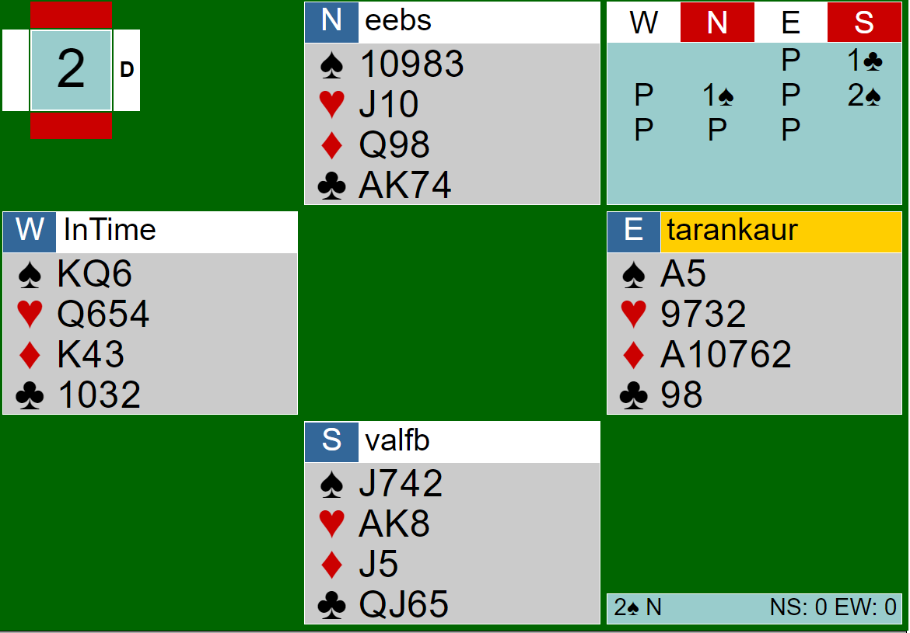

Slide 49
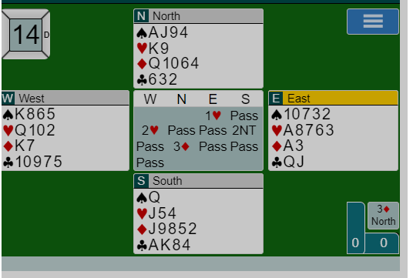

Slide 50
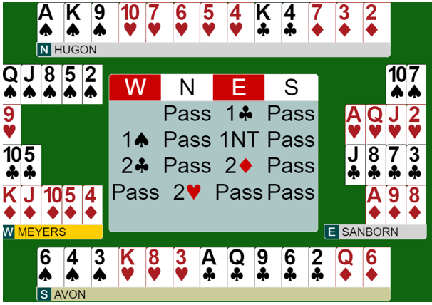
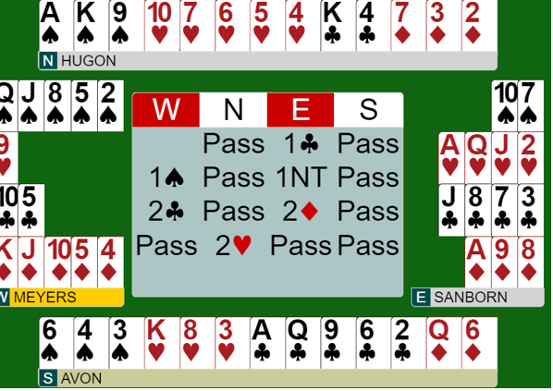

Slide 51
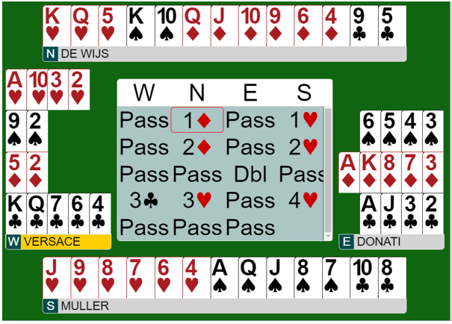

Slide 52
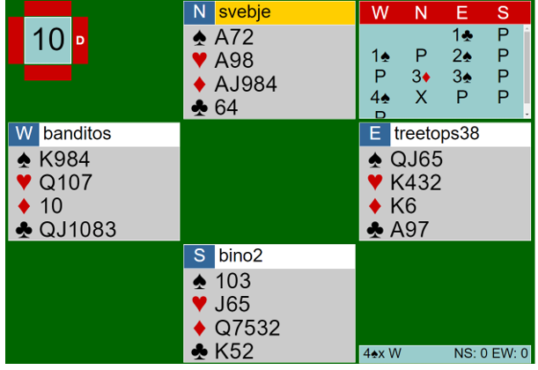

Slide 53
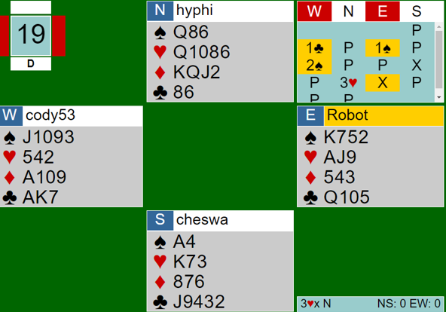

Slide 54
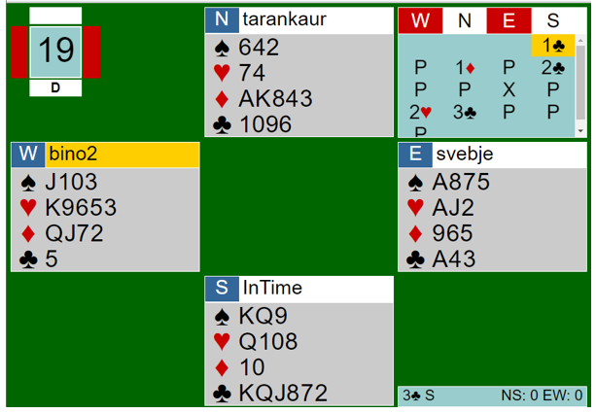

Slide 55
Conclusion
The bidding only ends after 3 passes
Make things difficult for your opponents
We remember disasters but forget small gains. Especially in pairs, we just need to have more gains than disasters (size doesn’t matter) to show a profit

Slide 56
Further reading
Complete book on balancing – mike lawrence

Slide 57
Thank you for your attention
Thanks to personal trust for sponsoring this lecture
Thanks to Carol Stanton for her assistance with this presentation

